Slide 1


Cynergy4MIE
Demo 4.2 Road Condition Monitoring
Contact:
Selim Solmaz, Kailin Tong, Virtual Vehicle Research GmbH
selim.solmaz@v2c2.at
kailin.tong@v2c2.at
Nov 19, 2025

Slide 2
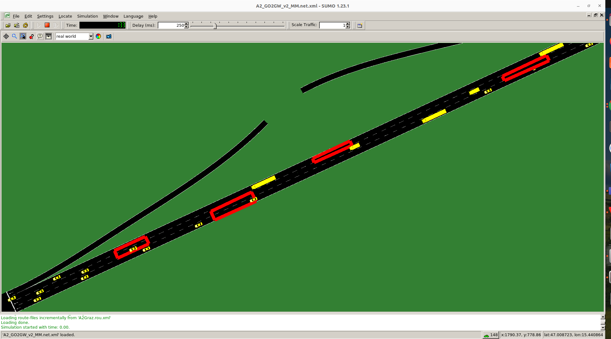
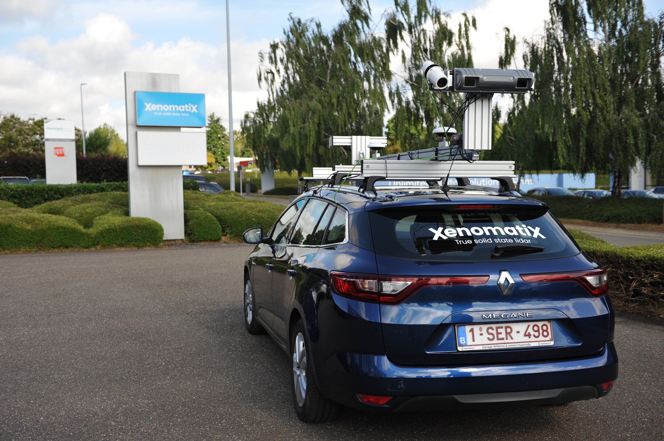
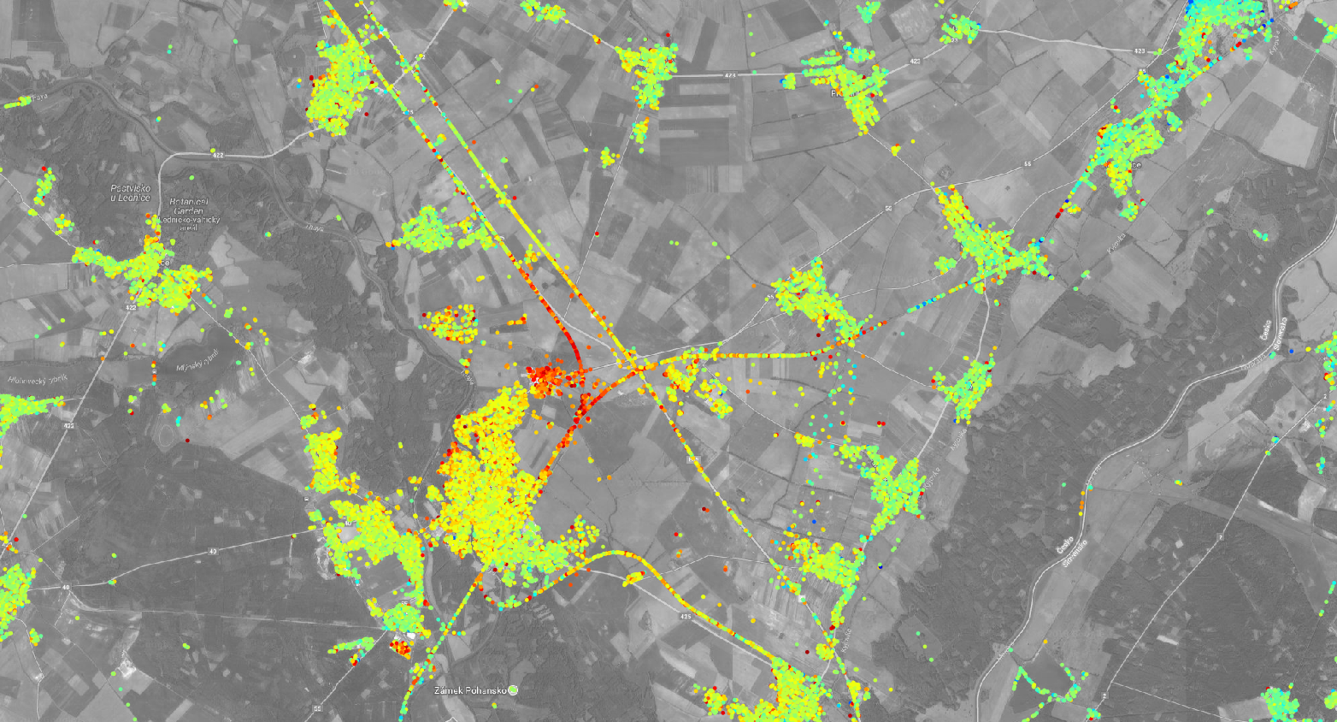
Demo 4.2 Road Condition Monitoring
SUMO traffic simulation
3 Use cases
Multiple sensors and different approaches for road condition monitoring
Joint road condition visualization and benchmark
Road survey vehicle
(source: XENOMATIX) ​
Satellite data (source: Insar.sk)

Slide 3
Demo 4.2 Road Condition Monitoring
Road Condition Monitoring
UC 1
AI-based Crowd-sourced Road Condition Estimation with Indirect Sensor measurements
UC 3
Prioritization of risk zones
Road Condition Monitoring with Satellite Data
Benchmark
UC 2
Road Condition Measurement with direct Real-World Sensor Data

Slide 4

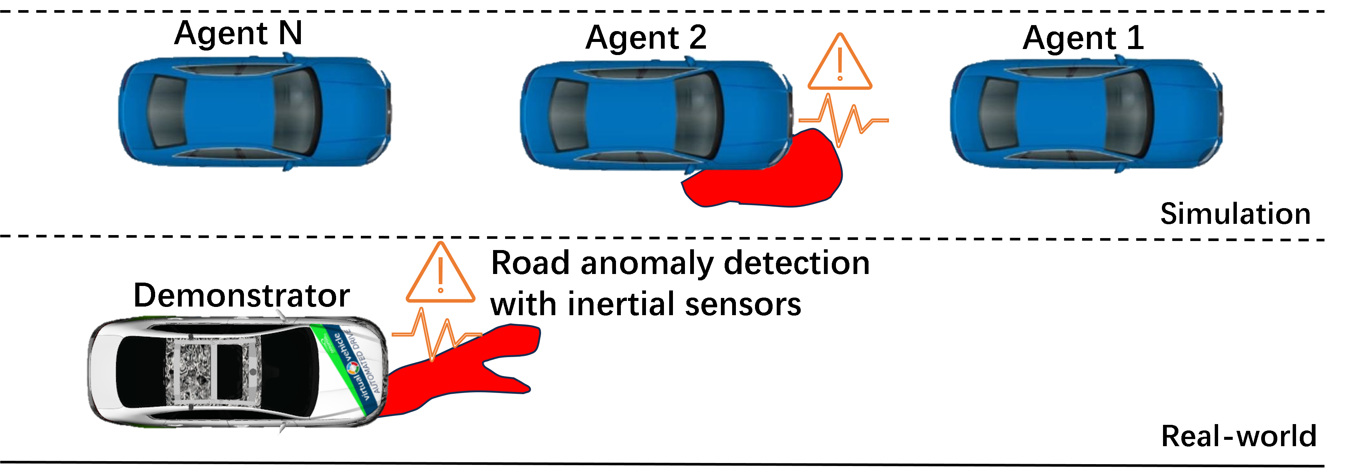




Demo 4.2 UC 1
UC 1: AI-based Crowd-sourced Road Condition Estimation with Indirect Sensor Measurements
SUMO simulation / test drive
Agents
UC 2 / UC 3
Road Anomalies
Road Anomaly Detection
AI-based crowd-sourced estimation system
Road Condition Map
Benchmark
UC 2

Slide 5
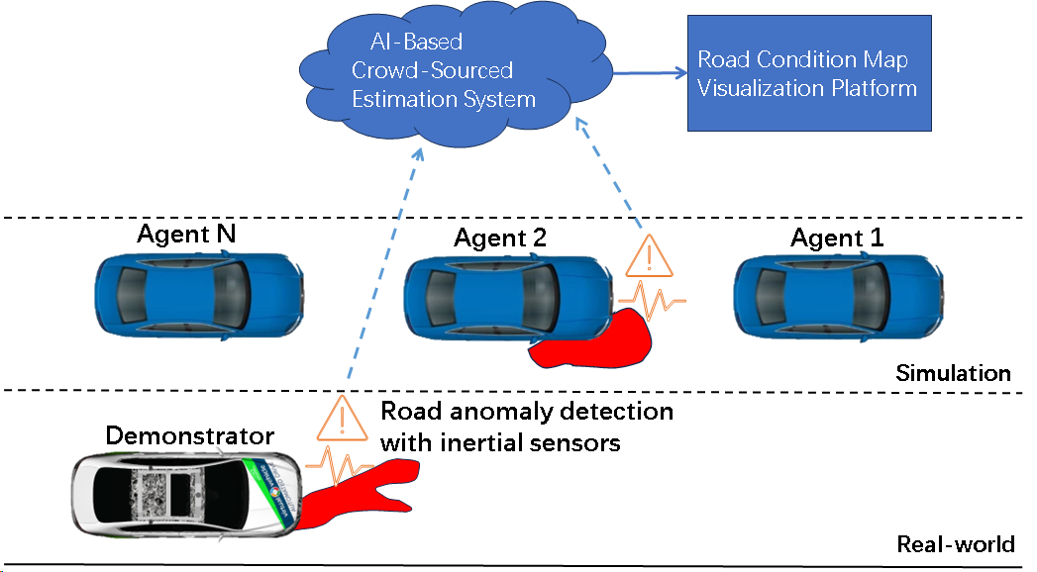
Demo 4.2 UC 1

Slide 6
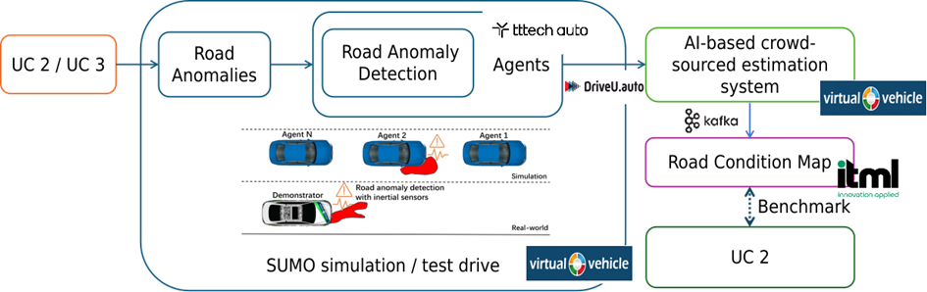
UC 4.2.1 Overview
Highlights
Indirect-measurement sensor fusion enabling AI-based crowd-sourced road-condition estimation.
Detection of UC2/UC3 anomalies via inertial sensors; multi-agent fusion from simulated and real vehicles.
Digital-twin and trace-driven network-emulation environment for realistic performance evaluation.
vECU ensuring deterministic execution, monitoring, debugging, and profiling of the detection layer.
Common visualization platform providing the shared Road Condition Map for UC2 benchmarking.
Notes:
The system for Demonstrator SCD 4.2 | UC1 integrates both simulation and real-world testing to validate AI-based, crowdsourced road condition estimation. Road anomalies, originating or indicated from UC2/UC3, are detected by fleets of vehicles through onboard inertial sensors. TTTech Auto (TAAT) provides the vECU that hosts the road anomaly detection layer, ensuring deterministic execution, monitoring, and debugging. Vehicles act as distributed agents, simulated in SUMO and validated through real-world test drives conducted by Virtual Vehicle (ViF). DriveU.auto (DriveU) designs and implements a trace-driven network emulation and simulation framework that captures real communication behavior of the in-house module, builds impairment profiles from packet traces, and recreates these profiles in a hardware-in-the-loop testbed to evaluate and validate system performance under realistic network conditions. Sensor events are transmitted to the cloud operations center, where an AI-based crowd-sourced estimation system, developed and orchestrated by Virtual Vehicle (ViF), aggregates multi-vehicle evidence to estimate anomaly position, type, severity, and confidence. Results are transmitted via the Kafka-based data streaming middleware and visualized as a Road Condition Map, which is shared with UC2 for benchmarking and maintenance planning. Itml (IOTAM) provides the common visualization platform, ensuring consistent map representation across all three use cases.

Slide 7
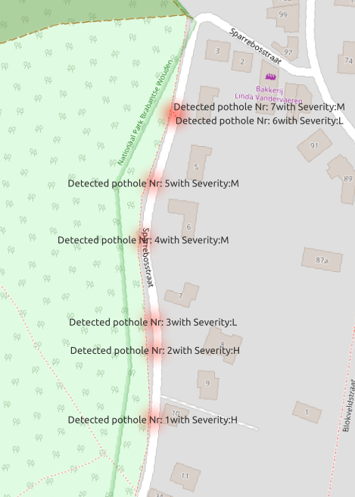
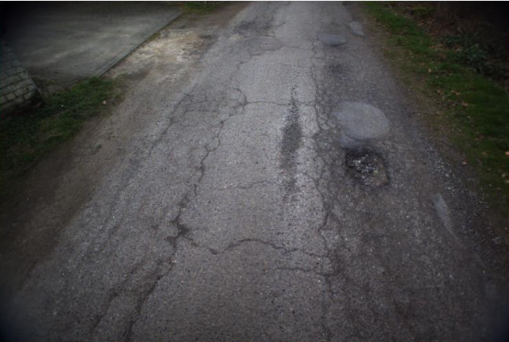
UC 4.2.1 Updates
Conversion of Ground truth data to a digital twin into SUMO simulation
Groundtruths
Pothole detection in Brussels urbna area ( source: Xenomatix data)

Slide 8
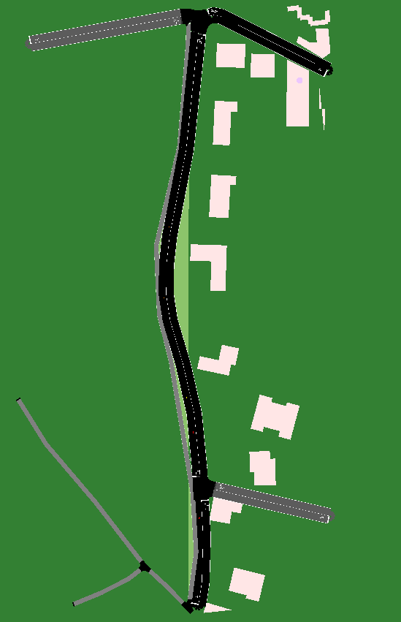
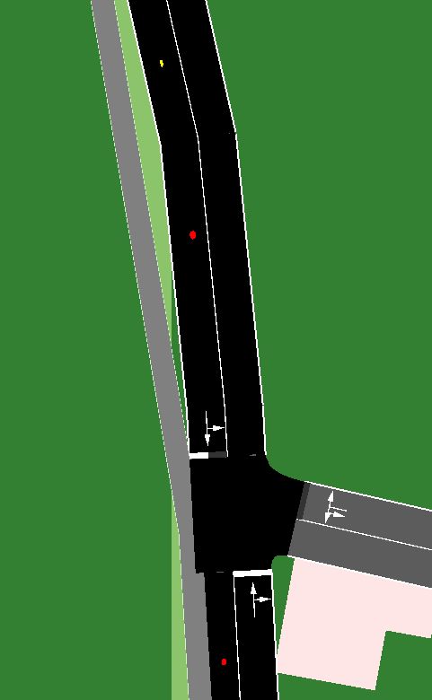
UC 4.2.1 Updates

Slide 9
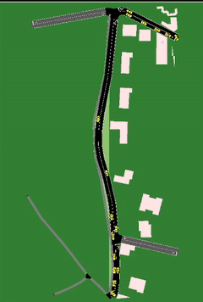
UC 4.2.1 Updates
Simulation setup
Noise GPS signals deviation: 5 m
Proabability of hitting model
Considering detection probability according to [1]
Traffic density: vehsPerHour="3600"

Slide 10
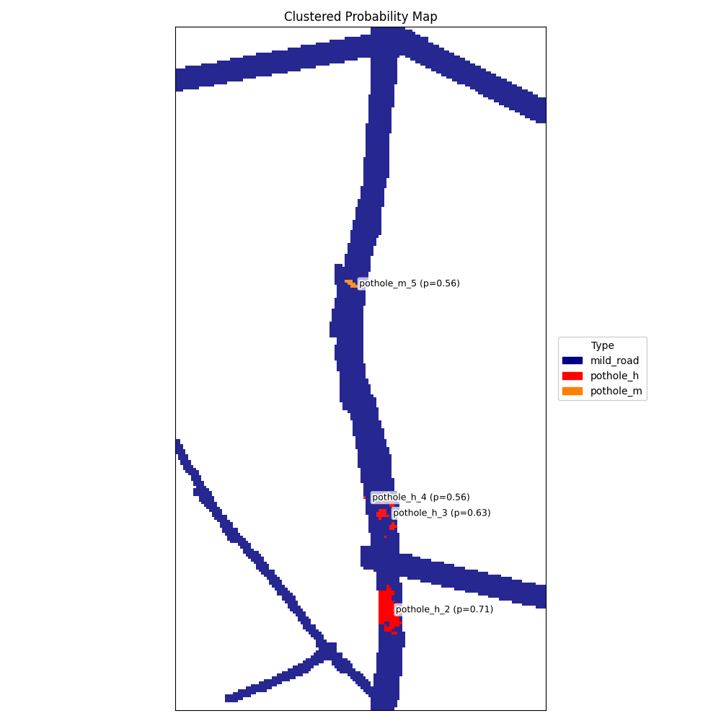
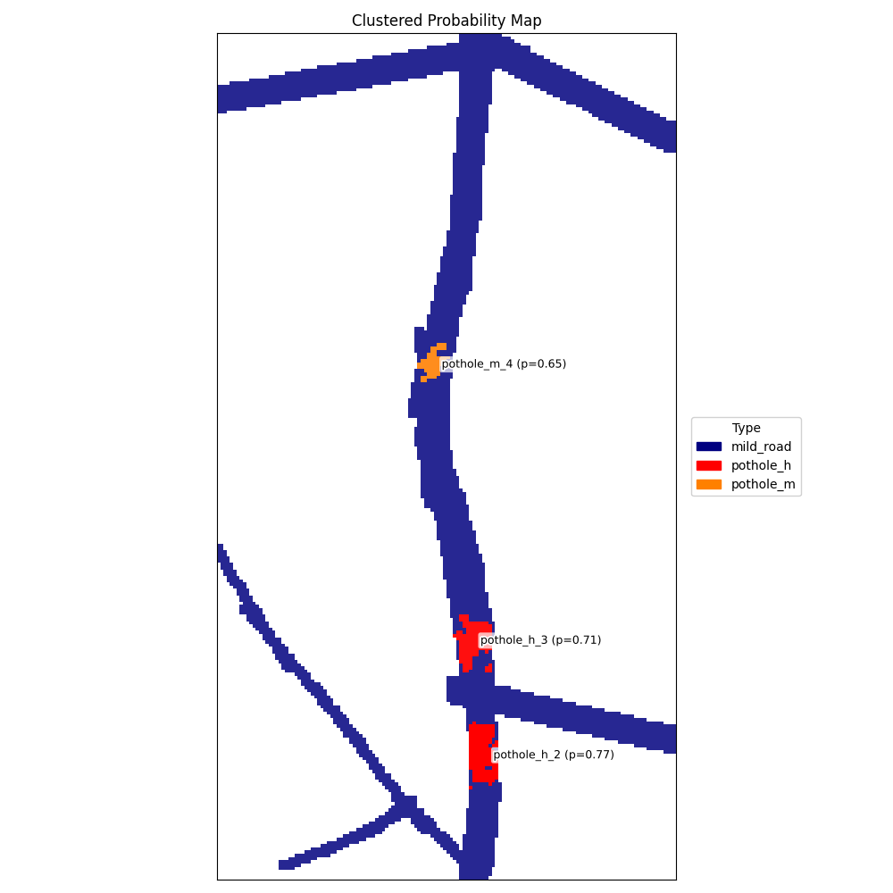
UC 4.2.1 Updates
Initial resutls
occupancy grid agrrgatingfor crowdsourced data aggregation
s

Slide 11
UC 4.2.1 Next Steps
1. ncluding another digital twin of a A2 highway segment.
2. Analizaing and utjilzation of A2 highway satellite data from InSAR
3. Improving the develped algorithms with more validation considering traffic parameters
4. Proof-of-concept the crowdsourcing appraoch.

Slide 12




Demo 4.2 UC 2
UC 2: Road Condition Measurement with direct Real-World Sensor Data
Road survey vehicle
UC 1
Virtual ECU
Vibration
Edge
AI
Test sites
Road Anomalies
Benchmark
Camera
Edge
AI
Road Condition Map
UC 3
LiDAR Camera
Edge
AI
For each sensor:
Which road KPIs are exported?
« live » or delayed export to visualization platform?

Slide 13
UC 4.2.2 Overview

Slide 14
UC 4.2.2 Updates

Slide 15
UC 4.2.2 Next Steps

Slide 16

Demo 4.2 UC 3
UC 3: Road Condition Monitoring with Satellite Data
Satellite data processing
Test site - a large scale
(e.g. city, region)
Road Condition Map
Risk areas identification
AI-based crowd-sourced estimation system
From large scale to prioritization of risk zones
UC1 / UC2 partners
Road Survey Vehicle

Slide 17
UC 4.2.3 Overview

Slide 18
UC 4.2.3 Updates

Slide 19
UC 4.2.3 Next Steps

